Slide 1
Recent Infection Surveillance among Pregnant Adolescent Girls and Young Women in Malawi
Rose Nyirenda
Ministry of Health, Malawi
Share your thoughts on this presentation with #IAS2019

Slide 2
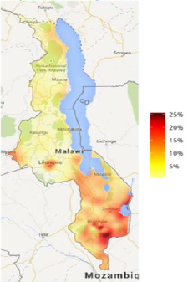
Malawi HIV Epidemic
Variations in
HIV prevalence (2016)
HIV Prev: 9.2%
Incidence: 0.45%
New Infections: 38,874

Slide 3
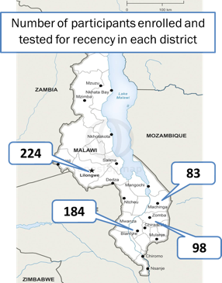
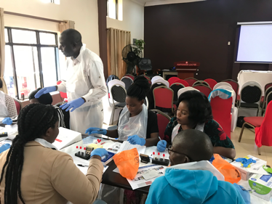
Implementation Timeline
Recency pilot infection among AGYW in 4 districts
Lab evaluation comparing LAg avidity assay to Asante Rapid test for recent infection (RTRI)
Nov 2017
April 2019
Routine recent infection surveillance at 23 sites in Blantyre District
Field evaluation of RTRI (Sedia Asante & Maxim Swift) at HTS compared to LAg avidity assay at lab
Include recency testing as operational research in HTS guidelines
July 2019
August 2019
Begin expansion of routine recent infection surveillance to 230 sites in 27 districts
Include as part of HIV testing algorithm in HTS guidelines
2020+
Notes:
Between November 2017 and July 2018,

Slide 4
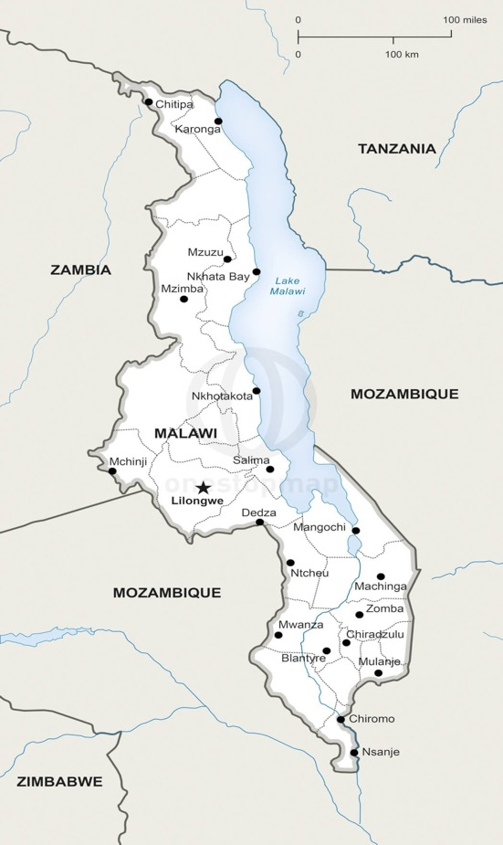
HIV Recency Pilot
Objectives
    To generate cross-sectional estimates of HIV incidence and recent infection among pregnant adolescent girls and young women (AGYW) attending their first ANC visit in public facilities
    To integrate recency testing and return of recency results into routine program service delivery
    To validate rapid test for recent infection (RTRI)
Population: AGYW attending first ANC visit and newly diagnosed HIV+ in Blantyre, Lilongwe, Machinga, & Zomba districts
Number of participants enrolled and tested for recency in each district
224
83
184
98
Notes:
A cross-sectional survey was integrated into routine ANC services in public health facilities in Blantyre, Lilongwe, Machinga and Zomba districts. All Ministry of Health (MOH) and Christian Health Association of Malawi (CHAM) health facilities offering ANC services in the four study districts were initially selected to be included as study sites. However, some facilities were eventually excluded if existing site staff were not available to work on the study. Of 155 public health facilities in the four districts, a total of 121 (78.1%) ANC sites were included in the study, including 29 of 41 in Blantyre, 44 of 55 in Lilongwe, 18 of 21 in Machinga, and 30 of 38 in Zomba. Study enrollment was conducted for six months in each of the selected sites, from November 2017 to May 2018 in Blantyre and Lilongwe and from February to July 2018 in Machinga and Zomba.

Slide 5
HIV Recency Pilot Results
 | Tested | LAg RITA Recent Infections
District | N | # | %
Blantyre | 184 | 22 | 12.0
Lilongwe | 224 | 32 | 14.3
Machinga | 83 | 9 | 10.8
Zomba | 98 | 5 | 5.1
Total | 589 | 68 | 11.7
About 1 in10 newly diagnosed pregnant AGYW at ANC were recently infected.
    Proportion of recent infections was lower in Zomba than other districts.
    Results indicated that AGYW were not being tested frequently/early enough.
Notes:
About 1 in10 newly diagnosed AGYW at ANC were recently infected.
About 9 in 10 were long-term infections.
Prevalence of recent infections was lower in Zomba than other districts
Results indicate that AGYW are not being tested frequently/early enough
In bivariable models, the prevalence of recent infection was significantly higher among AGYW who were in their first trimester of pregnancy (15.6%, 95% CI: 10.4-22.7, P = 0.02) than in their second (12.0%, 95% CI: 9.7-14.8) or third trimester (1.5%, 95% CI: 0.2-10.1)
No other variables were significantly associated with recent HIV infection among pregnant, HIV-infected AGYW enrolled in the study.
Between November 2017 to July 2018, pregnant AGYW aged 15–24 years, newly diagnosed with HIV at their first ANC visit in 121 facilities in Lilongwe, Blantyre, Machinga, and Zomba districts were consecutively enrolled. Participants completed behavioral questionnaires and provided blood samples to undergo the recent infection testing algorithm (RITA).
Based on the RITA, recent infection was defined as a normalized optical density value of ≤1.5 or ≤2.0 on the Limiting Antigen Avidity Enzyme Immunoassay (Maxim or Sedia, respectively) and viral load (VL) ≥1,000 copies/mL.
Prevalence of recent infection and annualized incidence were calculated using data abstracted from ANC registers on the number and serostatus of all AGYW attending ANC during the six-month study period, according to the estimator described by Kasanjee et. al¹.
We assumed a mean duration of recent infection of 161 days (95% confidence interval [CI]: 145–177 days), a 1% false recency rate, and that previously diagnosed AGYW had long-term infections.

Slide 6
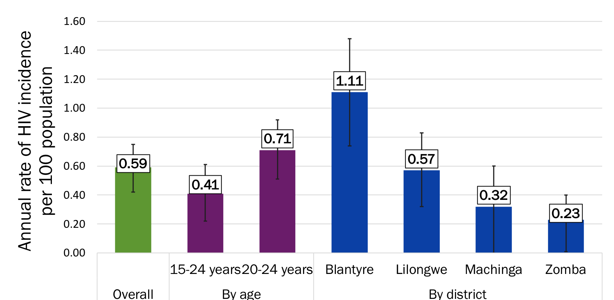
Estimates of HIV Incidence Among Pregnant AGYW, 2017-2018
Notes:
Annualized HIV incidence for pregnant AGYW attending ANC in the four districts was calculated using the LAg + VL algorithm (also known as the Recent Infection Testing Algorithm) results among participants in combination with aggregate data of HIV status of all AGYW attending ANC.
Overall annualized incidence was 0.59% (CI: 0.42-0.75).
Incidence was higher among AGYW aged 20-24 years (0.71%, CI: 0.51-0.92) than among AGYW aged 15-19 years (0.41%, CI: 0.22-0.61, p=0.04).
Incidence was significantly higher in Blantyre (1.11%, CI: 0.74– 1.48) than in Lilongwe (0.57%, CI: 0.32 – 0 .83, p=0.02), Machinga (0.32%, CI: 0.00 – 0.60, p <0.001) and Zomba (0.23%, CI: 0.00 – 0.40, p<0.001) districts
MPHIA 2015-16 showed annualized incidence among 15024 year old females at 0.38 (0.02, 0.74).

Slide 7
Correlation of Asante RTRI with LAg-Avidity
Asante visual at lab with VL | LAg avidity EIA with VL
 |  | Long-Term | Recent
 | Long-Term | 312 | 12
 | Recent | 5 | 41
N=370
95% agreement
Kappa = 0.82
Strong agreement between Asante RTRI and LAg when performed in lab and viral load testing included.
Notes:
NOTE: Whole blood was required to perform RTRI in the lab. A small number of sites collected DBS and therefore were not included in this comparison/analysis.

Slide 8
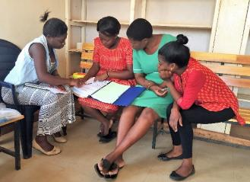
Return of HIV Recency Test Results
LAg + VL recency results returned to clinics: 99.5%
Results returned to AGYW: 78.6%
Results anecdotally well-received
Low return to scheduled follow up visits observed at some facilities
Notes:
So now we have results, what next? We returned about 100% of the LAg-RITA results to the clinics. About 80% of the results had been documented to have been returned to the AGYW. These results were based on the LAg + VL results.
Results were anecdotally well received. Low return to follow up visits was observed at some facilities

Slide 9
HIV Recent Infection Surveillance in Routine HTS

Slide 10
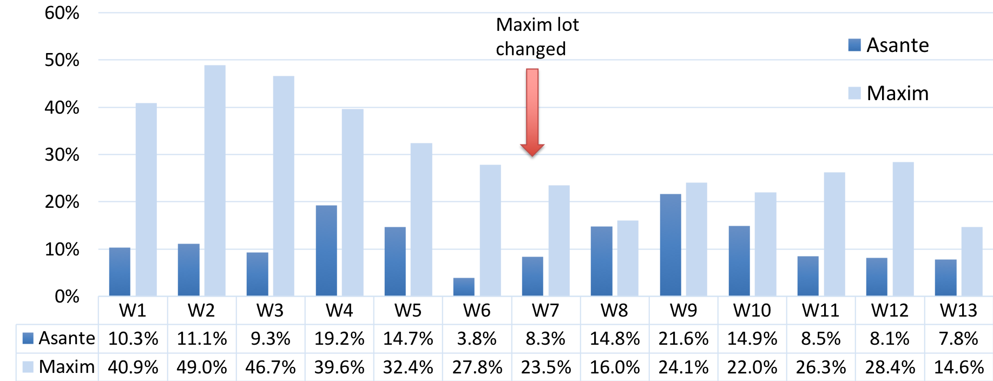
Proportion RTRI Recency Among Newly Diagnosed HIV Cases Enrolled by Test, Blantyre, Apr 4-Jul 5, 2019

Slide 11
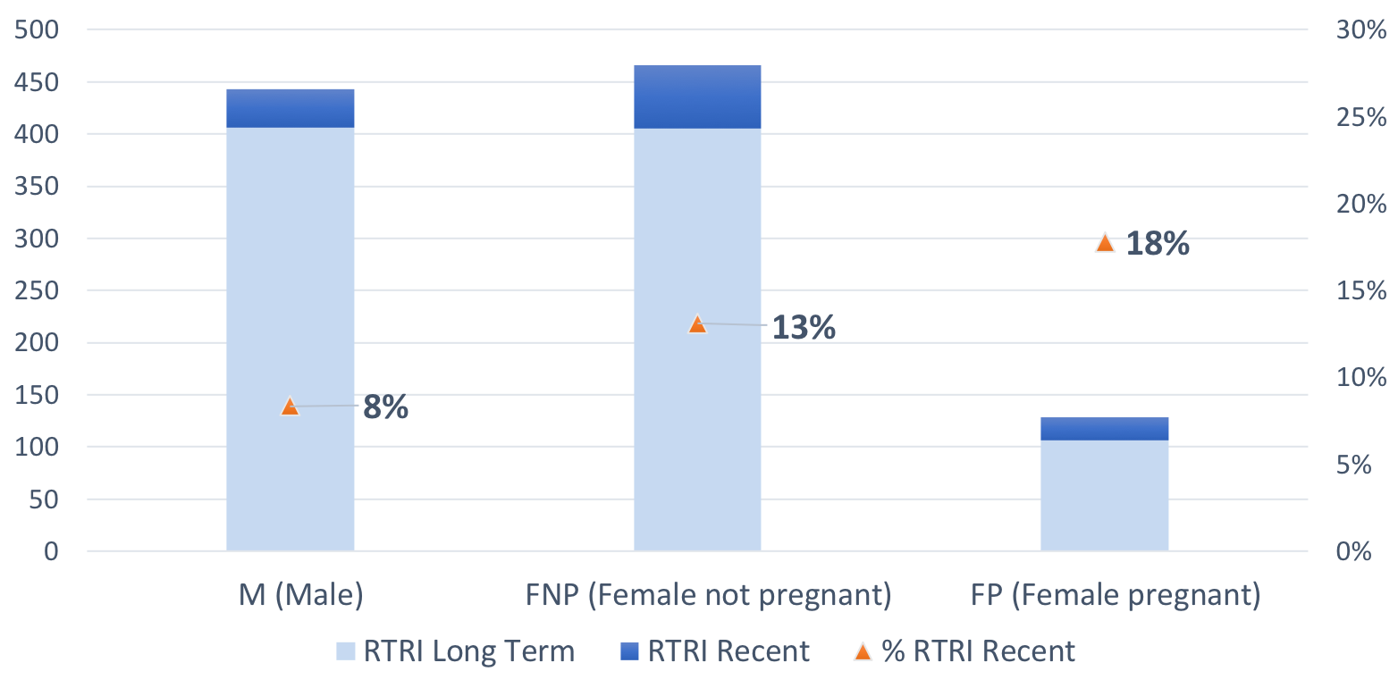
RTRI Results by Sex, April 4-July 5, 2019
(n=1038, Asante Sites)

Slide 12
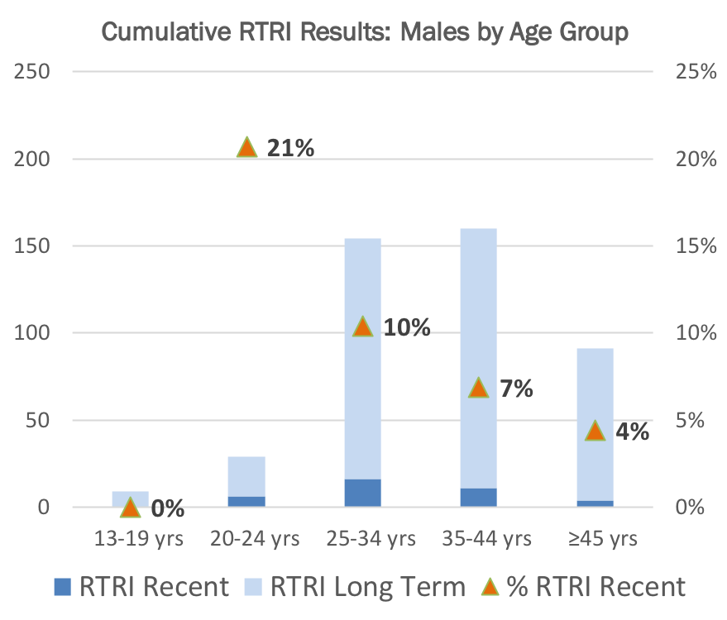
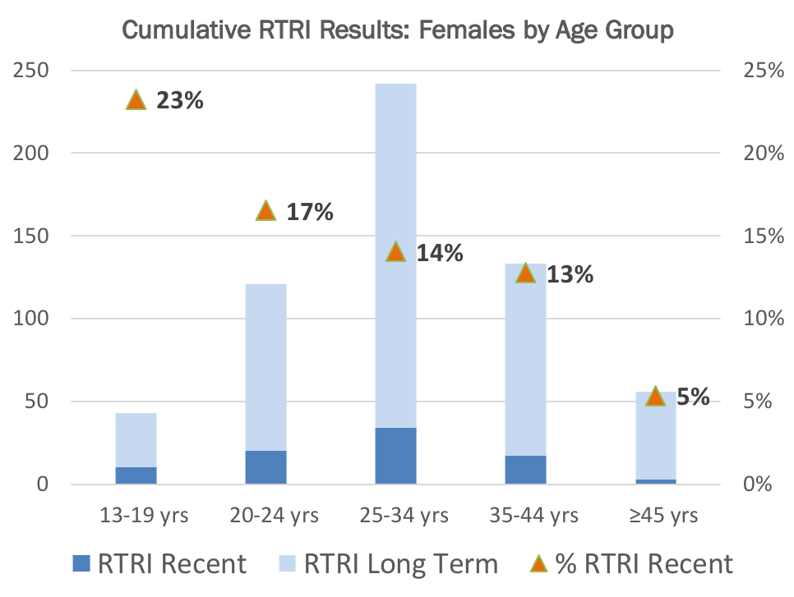
Recency Surveillance Preliminary Data, April 4-July 5, 2019
(n=1038, Asante Sites)

Slide 13
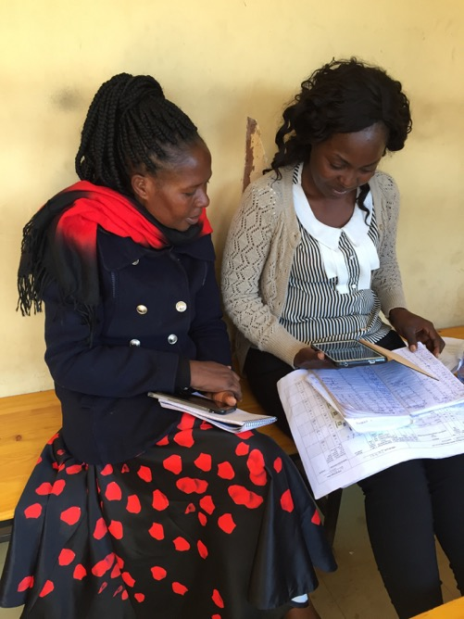
Next Steps
Complete field evaluation of RTRI at HTS vs. LAg at lab
Expand in phases to 27 districts
Use data for public health response
  Real-time dashboard to visualize results
  Discuss how to interpret and use results (e.g., prioritize geographic areas or sub-populations for HIV prevention interventions)

Slide 14
Zikomo!
Malawi Ministry of Health
Christian Health Association of Malawi
Office of the Global AIDS Coordinator (OGAC)
I-TECH, Malawi and Washington
University of California, San Francisco (UCSF)
Global AIDS Interfaith Alliance (GAIA), Malawi
Deforay, Inc
US Centers for Disease Control and Prevention (CDC), Malawi and Atlanta
USAID, Malawi
Antenatal clinic staff in participating districts
Laboratory staff (Kamuzu Central, Zomba Central, Queen Elizabeth, Machinga District hospital)
Participating adolescents girls and young women
Notes:
I would like to acknowledge the following collaborators for making this study possible.

Slide 15


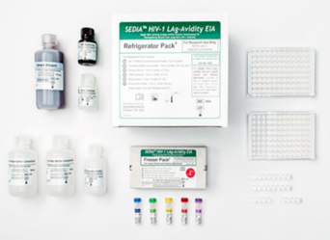
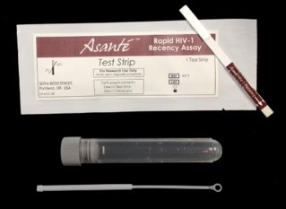
HIV Recency Pilot Design
Eligibility criteria
Pregnant AGYW aged 15-24 years
Initial antenatal clinic visit
Newly diagnosed with HIV at that visit
Questionnaire
Antenatal clinic
Blood specimen
LAg
Rapid test for recent infection
Recent Infection Testing Algorithm (RITA): Viral Load Testing for Recents
Laboratory
Notes:
Eligible AGYW were those pregnant, aged 15-24 years, who attended their initial antenatal visit for current pregnancy, and newly diagnosed with HIV at that visit. We consecutively enrolled eligible AGYW into the study.
After informed consent, [CLICK] a questionnaire was administered to collect demographic and behavioral information, and blood specimen was collected for testing in the laboratory.
[CLICK]The blood specimens were tested with LAg-RITA and rapid recency assay.
In select sites in Lilongwe, nurses performed both blood draw and point of care Asante rapid recency test the point of care Asante rapid recency test was also ad

Slide 16
HIV Recent Infection Surveillance in Routine HTS
RTRI performed by HIV Diagnostic Assistants within routine HIV testing (parallel to Test 2)
DBS collected for viral load confirmation of recent infection
Client RTRI results not returned; district recency test results to be made available during pre-test counseling
In planning: dashboard, cluster detection and response strategy

Slide 17
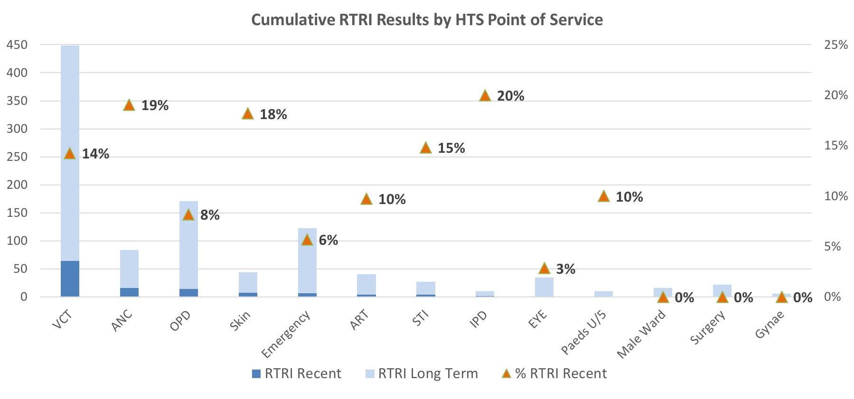
Recency Surveillance Preliminary data – April 4-July 5, 2019
(n=1038, Asante Sites)

